Slide 1
Whole Transcriptome Sequencing INITIAL ASSESMENT USING SMALL SAMPLE SIZE Vendor: Illumina

Slide 2
Utilities for WTS
Future-proof : No need to revalidate for each diseases and changing biomarkers
User-friendly workflow compared to Solid RNA (Exom capture)
Initial assessment indicates it can be cheaper as well for per sample

Slide 3
Current Status for RNA fusion and Expression
Heme: 225 driver RNA
Solid-RNA:250 Panel
Validated 31 driver genes based on importance for ALL
Launched for ALL (31 for Fusion and 2 for expression)
What we misses….

Slide 4
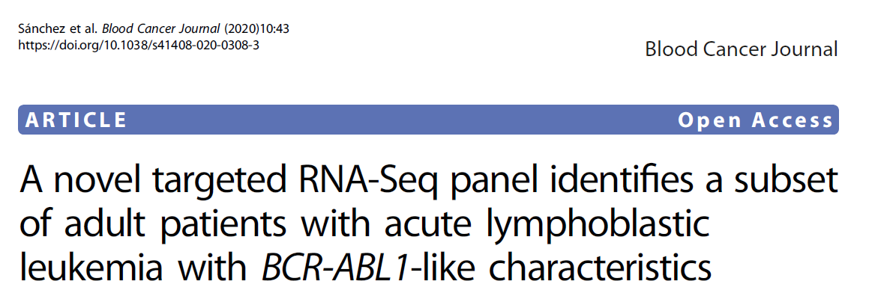
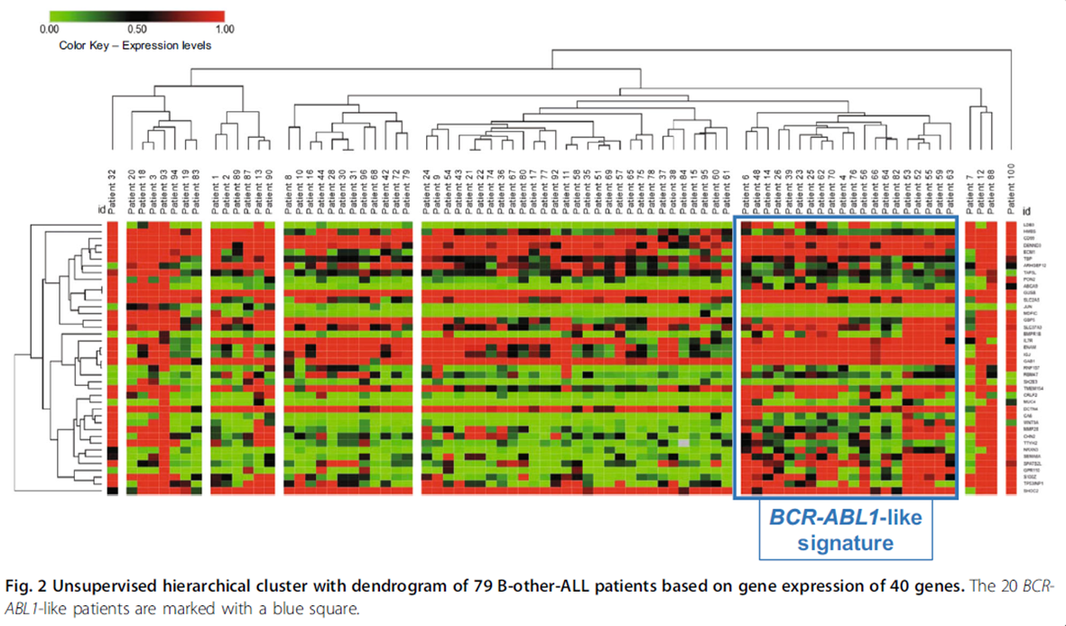
Major advantage: WTS can detect signature for sub-classifications
Example1
These are the expression markers from the subgrouping
ABCA9, ARHGEF12,BMPR1B, CA6, CD99, CHN2, CRLF2, DCTN4, DENND3,ECM1, ENAM, GAB1, GBP5, GPR110, IFITM1, IGJ, IL7R,LDB3, MDFIC, MMP28, MUC4, NRXN3, PON2, RBM47,RNF157, S100Z, SEMA6A, SCHIP1, SH2B3, SLC2A5,SLC37A3, SOC2, SPATS2L, TAF5L, TMEM154, TP53INP1,TTYH2, and WNT9A
We only cover CRLF2, SEMA6A and ARHGEF12
There are no complete signature in our panel
https://doi.org/10.1038/s41408-020-0308-3

Slide 5
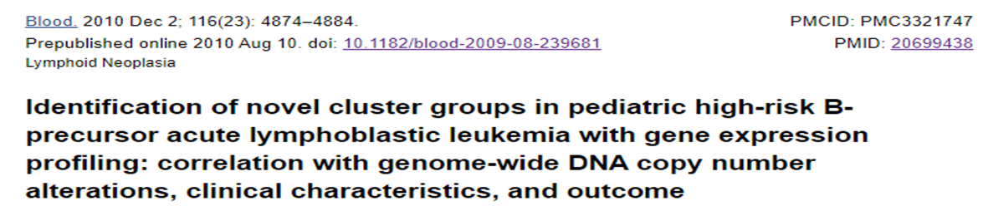
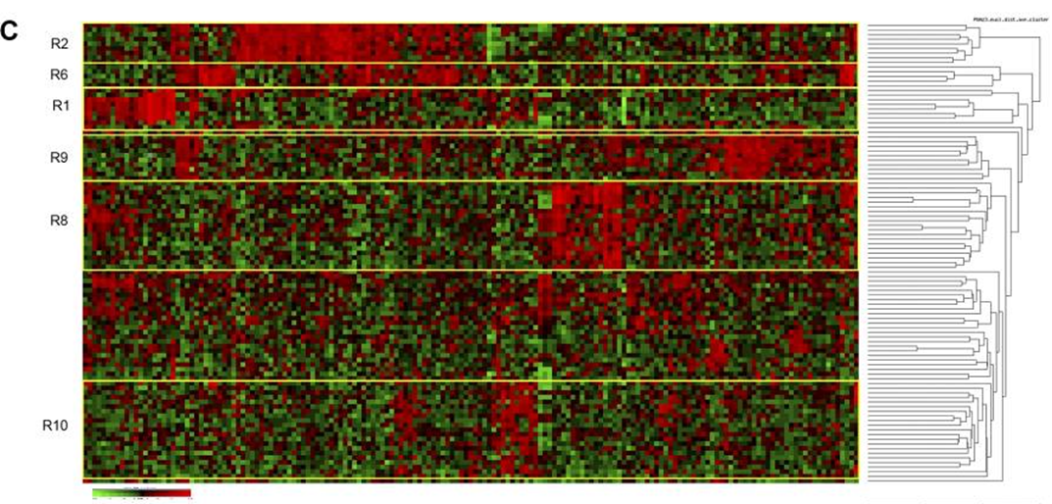
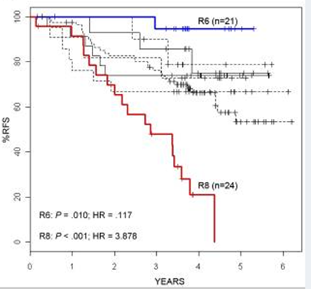
WTS can detect signature for sub-classifications
Example2
Reported BCR-ABL1 upregulated/down
regulated signature
BCR-ABL up-regulated | BCR-ABL down-regulated
Gene | Gene
TBXA2R | BACH2
ABL1 | CSF2RB
AGPS | CYP46A1
CA6 | IRS1
CD97 | KIAA0922
CD99 | LY9
CNN3 | PHYH
DCTN4 | WWC3
GIMAP6
GYPC
HIVEP2
IFITM1
IFITM3
IGJ
IL2RA
LIMD1
MMP28
MUC4
PON2
PRX
SEMA6A
SLC5A3
Cluster 8 has poor prognosis
Top 100 overexpression signature genes for ALL :
BMPR1B, CRLF2, GPR110, GPR171, IGJ, LDB3,MUC4
R8 Cluster membership overlap with RNA Panel from other genes
CRLF2 | R8
LAIR1 | R8
SEMA6A | R8
Only ABL1 and SEMA6A are covered in our panel

Slide 6
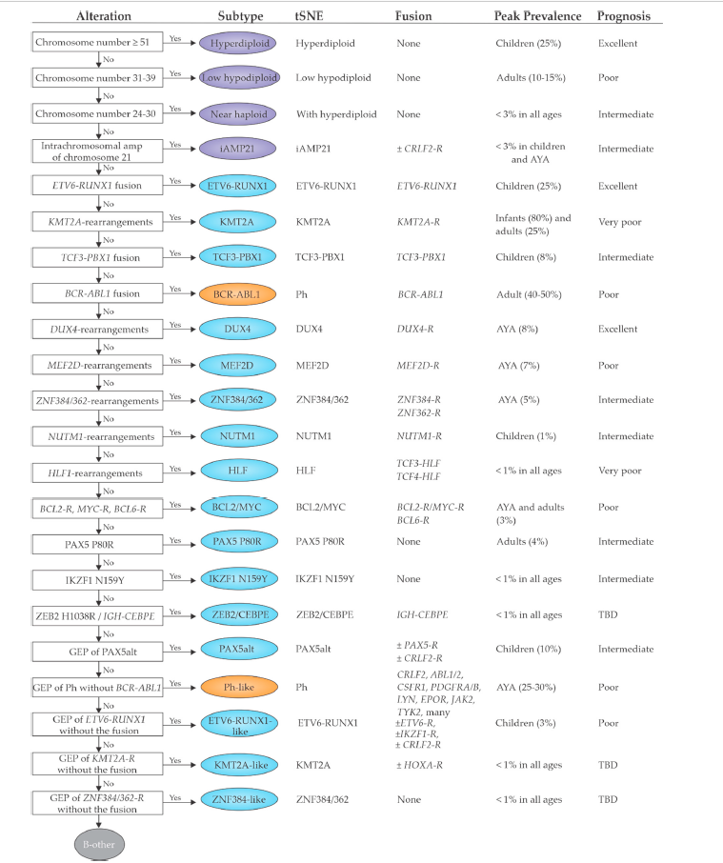

In summary WTS can find the signature profile for all sub-classes.
In literature already 22 subclasses of ALL are detected
Ph like ALL is distinct subclass
We cannot make the signature for disease subtyping under current situations

Slide 7
Cost Impact if we replace WTS for Solid-RNA fusion and Heme:
 | Supplier | Kit Name | Cat # | Cost | Samples | WTS_Cost/Sample | Solid (Cost/Sample) | Heme
Extraction | Promega | FFPE (RNA) | AS1440 | $426 | 48 | $8.88 | $ 8.88 | $ 8.88
Library Prep | Illumina | Illumina® Stranded Total RNA Prep, Ligation with Ribo-Zero Plus (96 Samples) | 20040529 | $6,624 | 96 | $69.00 |  | $109.38
Indexing | IDT/Illumina | IDT® for Illumina® RNA UD Indexes Set A, Ligation (96 Indexes, 96 Samples) | 20040553 | $638 | 96 | $6.65 |  | $10.25
Lib Pep Cost |  |  |  |  |  | $84.53 | $ 67.5 | $ 129.18
 | Number of reads (PE) | Required reads (PE) |  | Kit cost | Number of samples | Cost/Sample
NovaSeq SP 200 cycles v1.5 | 1.60E+09 | 1.00E+07 | 20040719 | $ 2,819.00 | 80 | $35.24 | $31.25 | $29.36
NovaSeq S1 200 cycles v1.5 | 3.20E+09 | 1.00E+07 | 20028318 | $ 4,971.00 | 160 | $31.07
 |  |  |  |  | Total Cost (for using SP) | $119.76 | $98.78 ($158 for lung 2.0) | $ 158.54/2=$76
 |  |  |  |  | Total Cost (for using S1) | $115.59
Cost decreases $43 for Solid ($158-$98; it can be cheaper as we confirm the min read required in even lower than 10M)
Cost Increases $39 wrt to Heme ($119-$76); together with both assay we almost make even to existing cost or may be little cheaper.
The WTS assay is future proof and saves the cost for step wise validation for different diseases or panel updates with clinical significances
The estimate for number of reads is based on initial experiment in feasibility phase, more data is coming up.

Slide 8
Workflow comparison for Solid Fusion and proposed WTS
 | Solid-RNA (CLIN-WI-0212) | Proposed WTS
rRNA depletion/probe remove enzymatically | Not Needed | 1 hr
Cleanup |  | 30 min
RNA Fragmentation | 1 min at 65C | 2 min
1st strand cDNA | 40 min | 40 min
2nd Strand synthesis and A tailing | 40 min | 60 min (plus cleanup 30 min+40 min for A-tailing)
Adapter Ligation | 20 min | 20 min
Adapter Cleanup | 30 min | 30 min
Library Amplification | About 30-40 min | 30 min
Adapter Cleanup | 30 min | Not needed
Hybridization (Includes SpeedVac to dry-down samples involving risk for salt-crystallization and follow-up treatment) | 2 hr+
Washes | 2 hr
Post-Capture PCR | 30-40 min
Cleanup | 30 min | 30 min
Estimated time (run time) | 500 min (about 8 hr approx.) | 302 min (5 hr run time)
Actual time | 2 to 3 days | 1-2 days

Slide 9
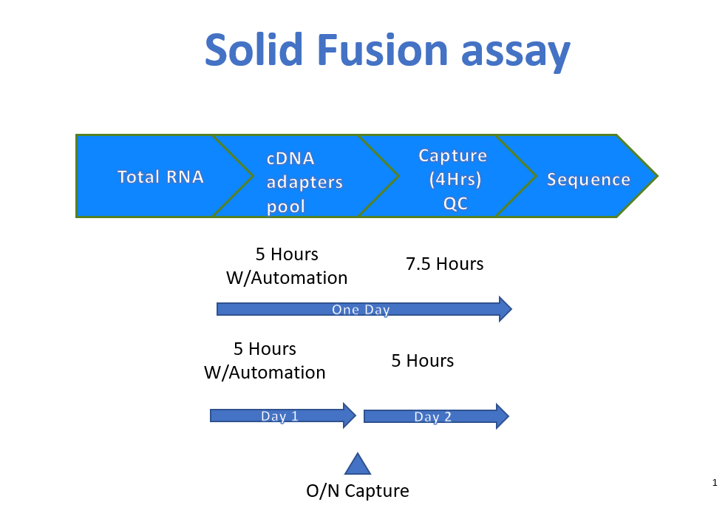

Slide 10
Chemistry and workflow and Kit selection for WTS

Slide 11
Kit comparison for WTS
 | Illumina (Experiment done) | Roche (KAPA) (Lib prep in progress) | Lexogen (in progress) | Takara (waiting kit)
FFPE | Yes | Yes | Yes | Yes
UMI Included | No | No | Yes (in Read 1) | No
Sample Input | 10 ng min for FFPE | Lowest limit is about 25 ng | 25 ng for FFPE | 10 -25 ng for FFPE
Claimed Runtime (Total) | 7 hr | <7 hr | 7 hr | 7-10 hr
Stranded | Yes | Yes | Yes | Yes
Human cytoplasmic rRNA | Depleted (Part of Kit workflow) | Depleted (Part of Kit workflow) | Not part of Kit_Same vendor | Not part of Kit_ Different vendor
Mitochondria rRNA | Depleted (Part of Kit workflow) | Depleted (Part of Kit workflow) | Not part of Kit_Same vendor | Not part of Kit_Different vendor
Human beta globin transcripts | Depleted (Part of Kit workflow) | Depleted (Part of Kit workflow) | Not part of Kit_Same vendor | Not part of Kit: Different vendor
Automation | Capable | Capable | Capable | Capable
Analysis | Included | Not Included | Included | Included
COGs (excluding sequencing) | About $100 per sample or less | About $100 per sample or less | About $120 per sample | About $100 per sample or less

Slide 12
Analysis comparison for cost and performance
 | Illumina-BaseSpace | In house Pipeline
Uses | Fusion Catcher | Arriba, Star Fusion
Other QC? | Softclip reads number, Junction reads | Read support on both sides, Machine learning probability score (F1), Junction counter
Specificity | Less Specific | Specificity is high
Adaptability | Like Blackbox with minimum chances to optimize | High to any extent
Cost | Cost associated for i-credit | No additional cost

Slide 13
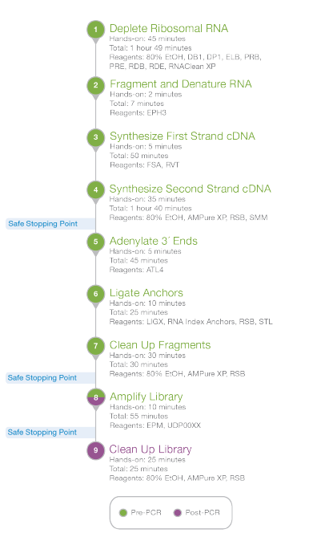
Chemistry and Workflow:Illumina Stranded Total RNA Prep, Ligation with Ribo-Zero™ Plus
Workflow:
Kit selection criteria:
 | Illumina
FFPE | Yes
Heme | Yes
Sample Input | 10 ng min for FFPE (min), 1 ng for Heme or cell line RNA
Runtime (Total) | <7 hr
Start to end | 2 days
Stranded | Yes
Human cytoplasmic rRNA | Depleted (Part of Kit workflow)
Mitochondria rRNA | Depleted (Part of Kit workflow)
Human beta globin transcripts | Depleted (Part of Kit workflow)
Automation | Capable
Analysis | Included
COGs (excluding sequencing) | About $100 per sample or less
Multiplexing | Can be multiplexed to 384 samples per run

Slide 14
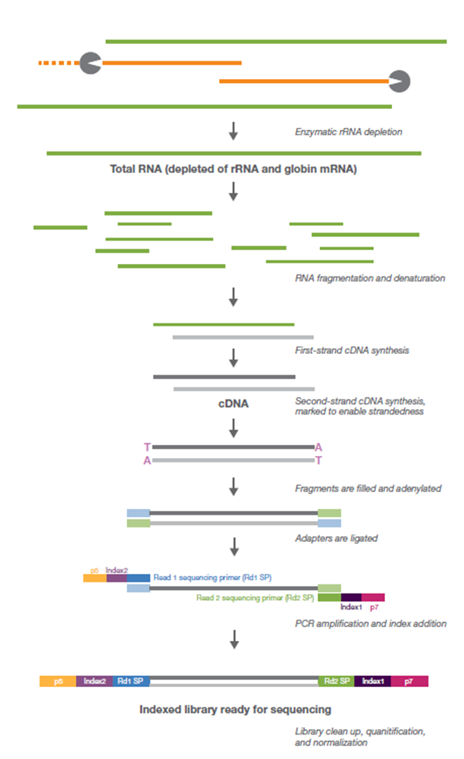
Illumina Kit
Chemistry and white Paper claim
Based on whitepaper:
Need 30M reads
Input 10 ng for FFPE (other samples can go to 1 ng)
More than 99% depletion for globin and >95% for rRNA
% duplication expected is about 5% until 10 ng and 20% for 1 ng input
Strandedness is >99%
Correlation coefficient >0.99 between replicates at 10 ng FFPE input

Slide 15
Library Preparations QC and run QC

Slide 16
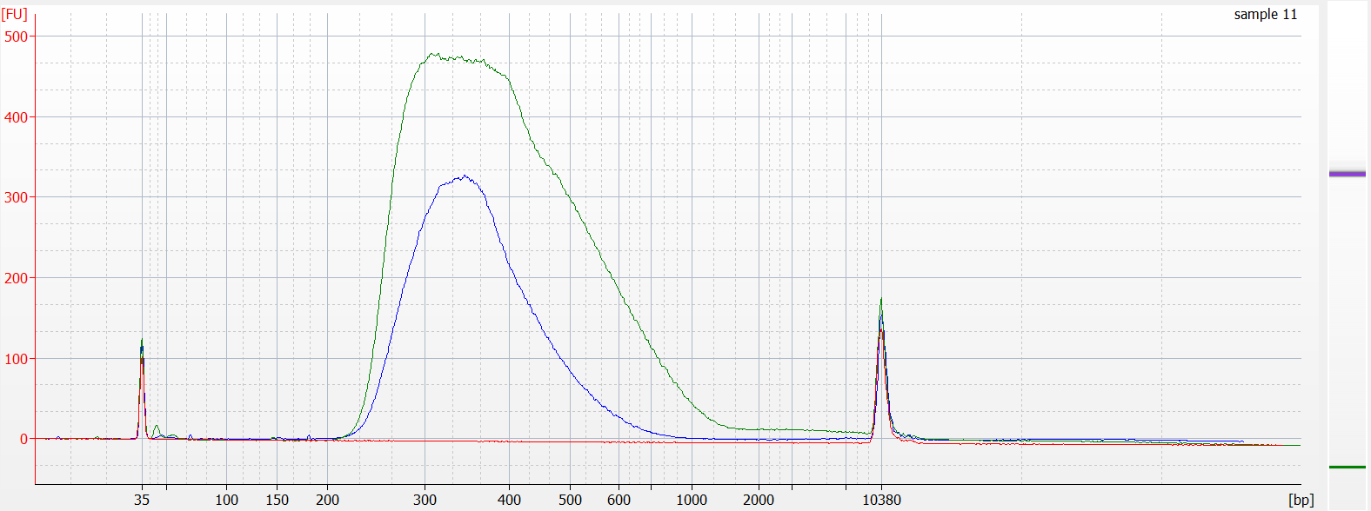
Library Preparation Performance
Seracare spikein library
FFPE library
NTC library
No significant adapter or primer dimer

Slide 17
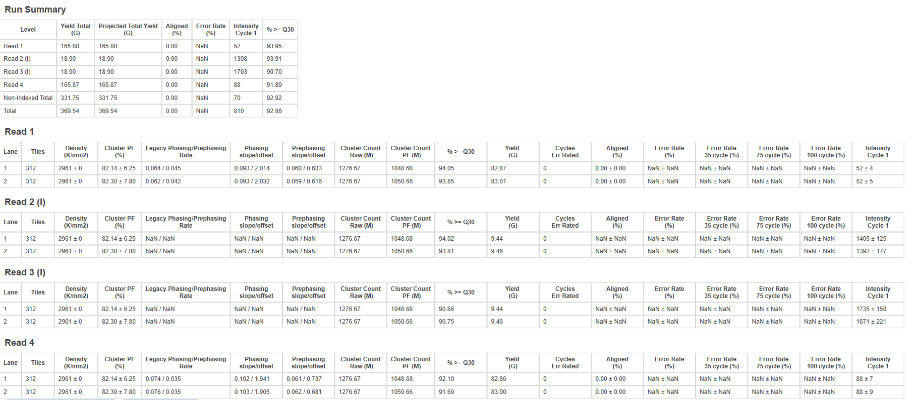
Sequencing Performances:
Avg Q30 >90
Avg PF: about 82%

Slide 18
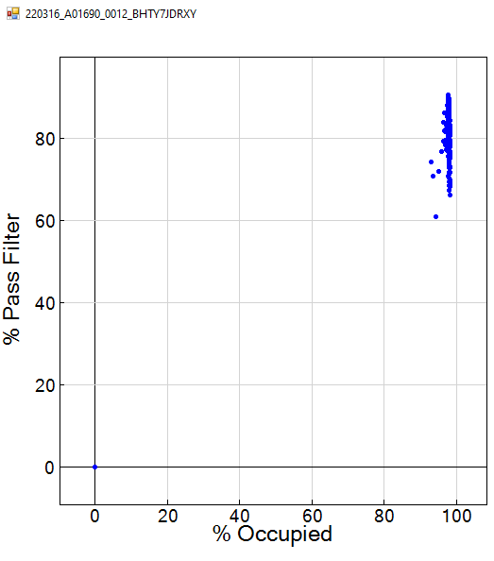
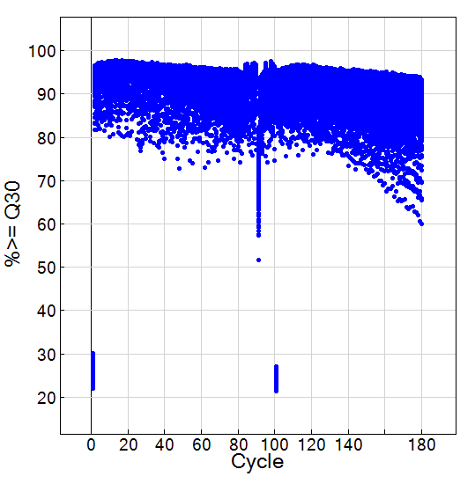
Clustering on Flowcell:
Run quality per cycle
Over clustered, loaded 100 pM (for 0.5 nM pool) as per recommendations as per recommendation
May use 0.45 nM pool to load
Recommended batch size: 16 samples for SP and 32 for S1

Slide 19
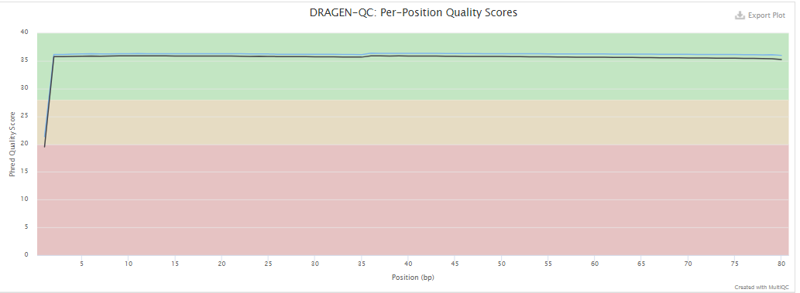
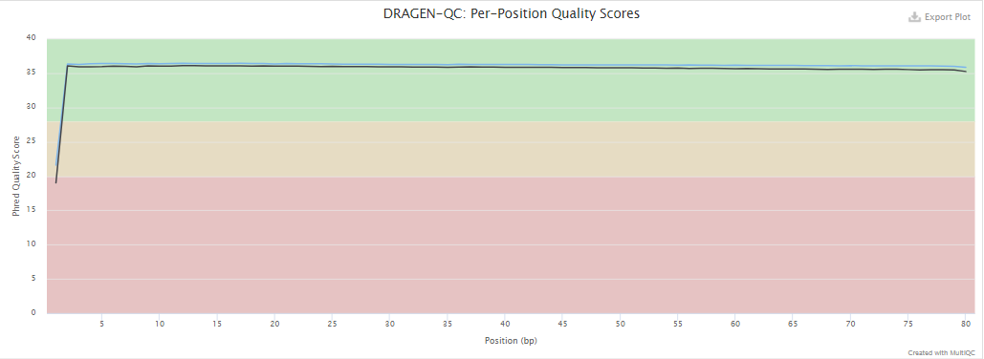
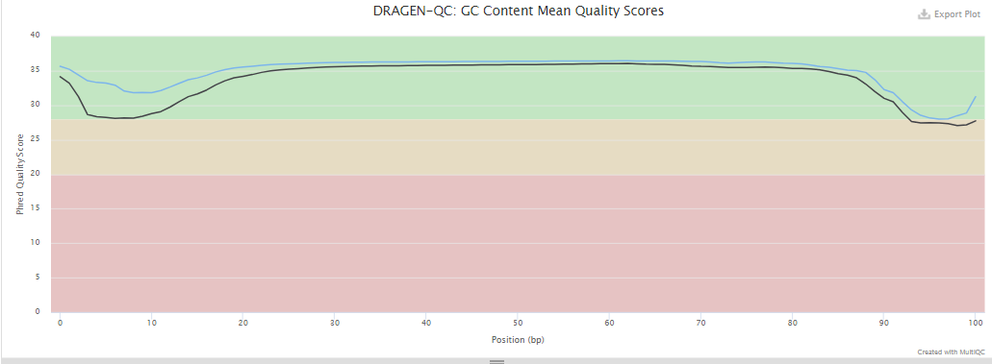
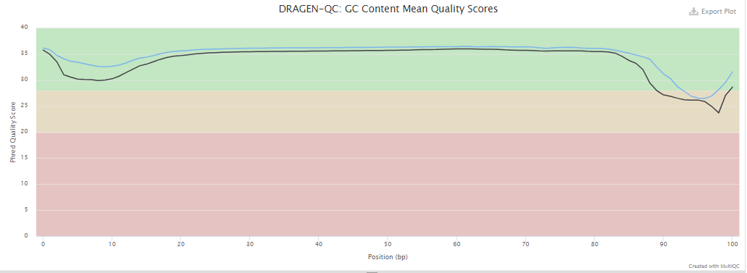
FFPE
Globin

Slide 20
MultiQC for Sequencing reads as function of input range
FFPE
Sample Name | M Input reads | Raw depth | Paired | QC-fail | Unmap | Dup | Prop pair | Discord | Singleton | Diff chr, MQ⩾10 | Med IS | M Alignments | Sec'ry
Ilm_MOL22-013125-100ng_26348371018 | 96.9 | 2.5 x | 100.00% | 0.00% | 0.80% | 31.70% | 96.50% | 2.58% | 0.12% | 1.85% | 130 | 120 | 19.28%
Ilm_MOL22-013125-100ng_26348371021 | 97.1 | 2.5 x | 100.00% | 0.00% | 0.80% | 32.60% | 96.40% | 2.59% | 0.16% | 1.85% | 139 | 120.3 | 19.26%
Sample Name | M Input reads | Raw depth | Paired | QC-fail | Unmap | Dup | Prop pair | Discord | Singleton | Diff chr, MQ⩾10 | Med IS | M Alignments | Sec'ry
Ilm_MOL22-013125-50ng_26348404469 | 60 | 1.5 x | 100.00% | 0.00% | 1.40% | 30.20% | 97.00% | 1.57% | 0.11% | 0.98% | 134 | 78.9 | 24.42%
Ilm_MOL22-013125-50ng_26348404470 | 60.1 | 1.5 x | 100.00% | 0.00% | 1.40% | 31.10% | 96.90% | 1.58% | 0.14% | 0.98% | 130 | 79 | 24.40%
Sample Name | M Input reads | Raw depth | Paired | QC-fail | Unmap | Dup | Prop pair | Discord | Singleton | Diff chr, MQ⩾10 | Med IS | M Alignments | Sec'ry
Ilm_MOL22-013125-25ng_26348405440 | 89.3 | 2.3 x | 100.00% | 0.00% | 1.10% | 40.90% | 97.30% | 1.54% | 0.09% | 0.99% | 137 | 115.2 | 22.81%
Ilm_MOL22-013125-25ng_26348405441 | 89.3 | 2.3 x | 100.00% | 0.00% | 1.10% | 42.60% | 97.20% | 1.55% | 0.11% | 0.98% | 139 | 115.3 | 22.83%
Sample Name | M Input reads | Raw depth | Paired | QC-fail | Unmap | Dup | Prop pair | Discord | Singleton | Diff chr, MQ⩾10 | Med IS | M Alignments | Sec'ry
Ilm_NTP21-045543-100ng_26348429846 | 58.4 | 1.5 x | 100.00% | 0.00% | 0.50% | 22.70% | 96.50% | 2.88% | 0.12% | 2.26% | 136 | 66.4 | 12.00%
Ilm_NTP21-045543-100ng_26348429847 | 58.3 | 1.5 x | 100.00% | 0.00% | 0.60% | 23.20% | 96.40% | 2.87% | 0.15% | 2.25% | 138 | 66.4 | 12.03%
Sample Name | M Input reads | Raw depth | Paired | QC-fail | Unmap | Dup | Prop pair | Discord | Singleton | Diff chr, MQ⩾10 | Med IS | M Alignments | Sec'ry
Ilm_NTP21-045543-50ng_26348466259 | 82.2 | 2.1 x | 100.00% | 0.00% | 0.80% | 29.50% | 96.50% | 2.56% | 0.12% | 1.99% | 138 | 93.7 | 12.38%
Ilm_NTP21-045543-50ng_26348466261 | 82.2 | 2.1 x | 100.00% | 0.00% | 0.90% | 30.40% | 96.40% | 2.57% | 0.15% | 1.99% | 136 | 93.7 | 12.38%
Sample Name | M Input reads | Raw depth | Paired | QC-fail | Unmap | Dup | Prop pair | Discord | Singleton | Diff chr, MQ⩾10 | Med IS | M Alignments | Sec'ry
Ilm_NTP21-045543-25ng_26348439883 | 69.9 | 1.8 x | 100.00% | 0.00% | 1.20% | 33.40% | 96.90% | 1.75% | 0.10% | 1.29% | 128 | 80.1 | 13.21%
Ilm_NTP21-045543-25ng_26348439885 | 70 | 1.8 x | 100.00% | 0.00% | 1.30% | 34.60% | 96.80% | 1.75% | 0.12% | 1.29% | 129 | 80.3 | 13.20%
Sample Name | M Input reads | Raw depth | Paired | QC-fail | Unmap | Dup | Prop pair | Discord | Singleton | Diff chr, MQ⩾10 | Med IS | M Alignments | Sec'ry
Ilm_NTP21-045543-12ng_26348448292 | 137.8 | 3.5 x | 100.00% | 0.00% | 1.50% | 46.50% | 97.30% | 1.11% | 0.09% | 0.69% | 135 | 165.5 | 17.37%
Ilm_NTP21-045543-12ng_26348448295 | 137.8 | 3.5 x | 100.00% | 0.00% | 1.60% | 48.60% | 97.20% | 1.11% | 0.11% | 0.69% | 130 | 165.4 | 17.36%
Globin
Sample Name | M Input reads | Raw depth | Paired | QC-fail | Unmap | Dup | Prop pair | Discord | Singleton | Diff chr, MQ⩾10 | Med IS | M Alignments | Sec'ry
JEA-021-100ng_26448386546 | 45 | 1.1 x | 100.00% | 0.00% | 0.60% | 27.10% | 95.80% | 3.48% | 0.14% | 2.67% | 134 | 52.9 | 14.82%
JEA-021-100ng_26448386548 | 45 | 1.1 x | 100.00% | 0.00% | 0.50% | 26.80% | 95.80% | 3.52% | 0.10% | 2.70% | 137 | 53.1 | 15.04%
Sample Name | M Input reads | Raw depth | Paired | QC-fail | Unmap | Dup | Prop pair | Discord | Singleton | Diff chr, MQ⩾10 | Med IS | M Alignments | Sec'ry
JEA-021-50ng_26448394619 | 55.8 | 1.4 x | 100.00% | 0.00% | 1.00% | 33.10% | 96.10% | 2.79% | 0.12% | 2.09% | 143 | 64.7 | 14.01%
JEA-021-50ng_26448394621 | 55.7 | 1.4 x | 100.00% | 0.00% | 1.00% | 32.40% | 96.10% | 2.83% | 0.09% | 2.13% | 136 | 64.7 | 14.19%
Sample Name | M Input reads | Raw depth | Paired | QC-fail | Unmap | Dup | Prop pair | Discord | Singleton | Diff chr, MQ⩾10 | Med IS | M Alignments | Sec'ry
JEA-021-25ng_26448378833 | 53.4 | 1.4 x | 100.00% | 0.00% | 0.90% | 39.00% | 97.00% | 1.94% | 0.13% | 1.36% | 139 | 62.3 | 14.48%
JEA-021-25ng_26448378834 | 53.3 | 1.4 x | 100.00% | 0.00% | 0.90% | 38.00% | 97.00% | 1.95% | 0.10% | 1.37% | 142 | 62.3 | 14.67%

Slide 21
Efficiency for r-RNA and Globin depletion
FFPE
Un-depleted
Sample Name | M Input reads | Raw depth | Paired | QC-fail | Unmap | Dup | Prop pair | Discord | Singleton | Diff chr, MQ⩾10 | Med IS | M Alignments | Sec'ry
MOL22-010778-100ng-EE_26448391827 | 54.4 | 1.4 x | 100.00% | 0.00% | 1.70% | 71.00% | 96.40% | 1.74% | 0.13% | 0.50% | 134 | 294 | 81.72%
MOL22-010778-100ng-EE_26448391829 | 55.1 | 1.4 x | 100.00% | 0.00% | 1.70% | 71.30% | 96.40% | 1.80% | 0.12% | 0.50% | 137 | 298.7 | 81.73%
Sample Name | M Input reads | Raw depth | Paired | QC-fail | Unmap | Dup | Prop pair | Discord | Singleton | Diff chr, MQ⩾10 | Med IS | M Alignments | Sec'ry
MOL22-010778-100ng_26448399602 | 43.2 | 1.1 x | 100.00% | 0.00% | 0.80% | 26.20% | 95.70% | 3.38% | 0.10% | 2.54% | 127 | 51 | 15.31%
MOL22-010778-100ng_26448399603 | 43.4 | 1.1 x | 100.00% | 0.00% | 0.80% | 25.70% | 95.80% | 3.34% | 0.08% | 2.49% | 129 | 51.3 | 15.43%
depleted
Globin
Sample Name | M Input reads | Raw depth | Paired | QC-fail | Unmap | Dup | Prop pair | Discord | Singleton | Diff chr, MQ⩾10 | Med IS | M Alignments | Sec'ry
JEA-020-100ng-EE_26448377137 | 54.5 | 1.4 x | 100.00% | 0.00% | 1.30% | 72.30% | 96.80% | 1.72% | 0.14% | 0.43% | 142 | 288.3 | 81.21%
JEA-020-100ng-EE_26448377139 | 55.1 | 1.4 x | 100.00% | 0.00% | 1.20% | 72.40% | 96.90% | 1.80% | 0.12% | 0.44% | 147 | 292.8 | 81.27%
Sample Name | M Input reads | Raw depth | Paired | QC-fail | Unmap | Dup | Prop pair | Discord | Singleton | Diff chr, MQ⩾10 | Med IS | M Alignments | Sec'ry
JEA-020-100ng_26448361556 | 39.4 | 1.0 x | 100.00% | 0.00% | 0.50% | 29.50% | 94.70% | 4.61% | 0.15% | 3.57% | 143 | 46.9 | 15.88%
JEA-020-100ng_26448361558 | 39.4 | 1.0 x | 100.00% | 0.00% | 0.50% | 29.20% | 94.70% | 4.66% | 0.10% | 3.62% | 143 | 47 | 16.11%
Sample Name | M Input reads | Raw depth | Paired | QC-fail | Unmap | Dup | Prop pair | Discord | Singleton | Diff chr, MQ⩾10 | Med IS | M Alignments | Sec'ry
JEA-020-50ng-EE_26448378695 | 44.4 | 1.1 x | 100.00% | 0.00% | 1.50% | 71.30% | 96.80% | 1.59% | 0.17% | 0.39% | 147 | 238.4 | 81.51%
JEA-020-50ng-EE_26448378697 | 44.7 | 1.1 x | 100.00% | 0.00% | 1.30% | 71.20% | 96.90% | 1.67% | 0.13% | 0.40% | 161 | 241.1 | 81.56%
Sample Name | M Input reads | Raw depth | Paired | QC-fail | Unmap | Dup | Prop pair | Discord | Singleton | Diff chr, MQ⩾10 | Med IS | M Alignments | Sec'ry
JEA-020-50ng_26448399157 | 52.2 | 1.3 x | 100.00% | 0.00% | 0.50% | 33.50% | 97.30% | 2.11% | 0.13% | 1.48% | 146 | 62.9 | 16.86%
JEA-020-50ng_26448399159 | 52.3 | 1.3 x | 100.00% | 0.00% | 0.50% | 33.10% | 97.30% | 2.13% | 0.09% | 1.50% | 142 | 63.2 | 17.09%
Un-depleted
depleted
Un-depleted
depleted

Slide 22
Depletion efficiency is high and performances are similar at different input
Sample | Pass/Fail | Initial # | % Bases | Insert | % Mito- | % Ribo- | % Dupli- | Filtered | % Passed | % Mapped | % Uniquely | % Exonic | % Reads | Avg Target | Avg Known | Avg Novel | 5'/3'
 |  | Reads (M) | >= Q30 | Length | chondrial | somal | cates | Reads (M) | Filters | Reads | Mapped | Reads | On Target | Coverage | Junc Cov | Junc Cov | Bias
MOL22-010778-100ng | PASS | 86.58 | 93.98 | 125 | 1.07 | 1.73 | N/A | 83.25 | 96.16 | 95.23 | 95.41 | 22.21 | N/A | N/A | 19 | 1.8 | 1.01
MOL22-010778-100ng-EE | PASS | 109.49 | 93.81 | 126 | 3.45 | 69.71 | N/A | 27 | 24.66 | 93.49 | 90.35 | 22.94 | N/A | N/A | 9 | 2 | 1.02
MOL22-010778-50ng | PASS | 105.39 | 93.78 | 125 | 0.78 | 1.73 | N/A | 101.24 | 96.07 | 95.78 | 95.52 | 21.75 | N/A | N/A | 22 | 2 | 1.04
MOL22-010778-50ng-EE | PASS | 121.17 | 93.67 | 126 | 3.19 | 70.5 | N/A | 28.98 | 23.92 | 90.15 | 87.15 | 22.33 | N/A | N/A | 9 | 2.1 | 1
JEA-020-100ng | PASS | 78.76 | 93.45 | 125 | 0.35 | 1.47 | N/A | 76.68 | 97.36 | 94.19 | 94.46 | 21.88 | N/A | N/A | 22 | 1.8 | 1.06
JEA-020-100ng-EE | PASS | 109.63 | 92.82 | 126 | 3.69 | 69.09 | N/A | 27.18 | 24.8 | 94.31 | 89.42 | 22.96 | N/A | N/A | 11 | 1.8 | 1
JEA-020-50ng | PASS | 104.5 | 93.47 | 125 | 0.29 | 1.84 | N/A | 101.47 | 97.09 | 96.76 | 94.34 | 21.95 | N/A | N/A | 28 | 2 | 1.07
JEA-020-50ng-EE | PASS | 89.14 | 92.37 | 126 | 3.34 | 70.33 | N/A | 21.15 | 23.73 | 94.37 | 90.13 | 23.18 | N/A | N/A | 9 | 1.8 | 1.02

Slide 23
Insert length at 12.5 ng dropped significantly but in Heme it did not change until 25 ng input
Sample | Pass/Fail | Initial # | % Bases | Insert | % Mito- | % Ribo- | % Dupli- | Filtered | % Passed | % Mapped | % Uniquely | % Exonic | % Reads | Avg Target | Avg Known | Avg Novel | 5'/3'
 |  | Reads (M) | >= Q30 | Length | chondrial | somal | cates | Reads (M) | Filters | Reads | Mapped | Reads | On Target | Coverage | Junc Cov | Junc Cov | Bias
MOL22-010778-100ng | PASS | 86.58 | 93.98 | 125 | 1.07 | 1.73 | N/A | 83.25 | 96.16 | 95.23 | 95.41 | 22.21 | N/A | N/A | 19 | 1.8 | 1.01
MOL22-010778-50ng | PASS | 105.39 | 93.78 | 125 | 0.78 | 1.73 | N/A | 101.24 | 96.07 | 95.78 | 95.52 | 21.75 | N/A | N/A | 22 | 2 | 1.04
MOL22-010778-25ng | PASS | 152.85 | 93.78 | 118 | 0.61 | 2.19 | N/A | 145.32 | 95.07 | 96.92 | 95.34 | 21.94 | N/A | N/A | 33 | 2.5 | 1.02
MOL22-010778-12ng | PASS | 130.77 | 92.66 | 35 | 0.47 | 2.24 | N/A | 120.36 | 92.04 | 96.57 | 95.33 | 21.83 | N/A | N/A | 29 | 2.8 | 1.03
JEA-021-100ng | PASS | 90.07 | 93.46 | 125 | 0.2 | 1.8 | N/A | 87.47 | 97.12 | 95.53 | 95.24 | 27.36 | N/A | N/A | 31 | 2 | 1.07
JEA-021-50ng | PASS | 111.49 | 93.5 | 125 | 0.16 | 1.62 | N/A | 108.1 | 96.96 | 96.19 | 95.38 | 27.26 | N/A | N/A | 37 | 2.2 | 1.07
JEA-021-25ng | PASS | 106.68 | 93.53 | 125 | 0.14 | 1.73 | N/A | 103.44 | 96.97 | 96.95 | 95.33 | 27.42 | N/A | N/A | 37 | 2.3 | 1.12
JEA-020-100ng | PASS | 78.76 | 93.45 | 125 | 0.35 | 1.47 | N/A | 76.68 | 97.36 | 94.19 | 94.46 | 21.88 | N/A | N/A | 22 | 1.8 | 1.06
JEA-020-50ng | PASS | 104.5 | 93.47 | 125 | 0.29 | 1.84 | N/A | 101.47 | 97.09 | 96.76 | 94.34 | 21.95 | N/A | N/A | 28 | 2 | 1.07
JEA-020-25ng | PASS | 603.1 | 93.08 | 125 | 0.23 | 2.27 | N/A | 581.03 | 96.34 | 97.43 | 94.22 | 22.12 | N/A | N/A | 131 | 3.9 | 1.07
Solid QC
MOL22-010778 | PASS | 12.10 | 82.34 | 268 | 0.34 | 5.61 | 49.19 | 5.20 | 43.01 | 95.28 | 94.84 | 74.10 | 69.25 | 577 | 225 | 3.4 | 5.23

Slide 24
Whole Transcriptome Sequencing-DATA INITIAL ASSESMENT USING SMALL SAMPLE SIZE Vendor: Illumina

Slide 25
Fusion
Chemistry evaluation for input range (FFPE and Globin)
Chemistry evaluations for tumor dilution (FFPE and Globin)
Chemistry evaluation for required number of reads as function to input range
Run to run performance evaluations
Base apace DRAGEN server vs in-house analysis pipeline
Observation:
Steady performance until 25 ng of input for FFPE and Globin samples
Minimum amount of reads required is 10M from 100 ng to 25 ng input
Initial Run-to-run performance is robust (need to more samples and run)
In-house pipeline is more specific with built-in QC metrics

Slide 26
Input Range: Two FFPE samples compared in Solid, Dragen and WTS-in-house pipeline
FFPE_Sample1
MOL22-013125
Input | Solid Chemistry | WTS_Solid workflow | WTS_Basespcase workflow
100 ng | ETV6--NTRK3 (input 200 ng?) | ETV6--NTRK3 | ETV6--NTRK3
50 ng | NA | ETV6--NTRK3 | ETV6--NTRK3
25 ng | NA | ETV6--NTRK3 | ETV6--NTRK3
12.5 ng | NA | ETV6--NTRK3 | ETV6--NTRK3
MOL22-013125_S3
Fccall | Brk1 | Brk2 | FC1 | FC2 | sfcall | SF1 | SF2 | A1 | A2 | F1
ETV6:NTRK3 | 12:11869969 | 15:87940753 | 34 | 21 | ETV6:NTRK3 | 103 | 20 | 43 | 17 | 0.73
MOL22-013125_50ng_S18
Fccall | Brk1 | Brk2 | FC1 | FC2 | sfcall | SF1 | SF2 | A1 | A2 | F1
ETV6:NTRK3 | 12:11869969 | 15:87940753 | 25 | 17 | ETV6:NTRK3 | 91 | 13 | 55 | 14 | 0.67
MOL22-013125_25ng_S19
Fccall | Brk1 | Brk2 | FC1 | FC2 | sfcall | SF1 | SF2 | A1 | A2 | F1
ETV6:NTRK3 | 12:11869969 | 15:87940753 | 21 | 22 | ETV6:NTRK3 | 117 | 10 | 75 | 19 | 0.75
MOL22-013125_12.5ng_S20
Fccall | Brk1 | Brk2 | FC1 | FC2 | sfcall | SF1 | SF2 | A1 | A2 | F1
ETV6:NTRK3 | 12:11869969 | 15:87940753 | 20 | 18 | ETV6:NTRK3 | 51 | 10 | 31 | 14 | 0.67
FFPE_Sample2
MOL22-010778-N
Input (ng) | Solid Workflow
100 | KANSL1:ARL17A
50 | KANSL1:ARL17A
25 | KANSL1:ARL17A
12.5 | ND
MOL22-010778-N-100ng_N_S24
Fccall | Brk1 | Brk2 | FC1 | FC2 | FCFrame | sfcall | SF1 | SF2 | Arbcall | A1 | A2 | F1
KANSL1:ARL17A | 17:46094560 | 17:46570869 | 16 | 18 | out-of-frame | KANSL1:ARL17A | 32 | 11 |  | 0 | 0 | 0.62
MOL22-010778-50ng_N_S25
Fccall | Brk1 | Brk2 | FC1 | FC2 | FCFrame | sfcall | SF1 | SF2 | Arbcall | A1 | A2 | F1
KANSL1:ARL17A | 17:46094560 | 17:46570869 | 11 | 15 | out-of-frame | KANSL1:ARL17A | 58 | 10 |  | 0 | 0 | 0.47
MOL22-010778-25ng_N_S26
Fccall | Brk1 | Brk2 | FC1 | FC2 | FCFrame | sfcall | SF1 | SF2 | Arbcall | A1 | A2 | F1
KANSL1:ARL17A | 17:46094560 | 17:46570869 | 8 | 17 | out-of-frame | KANSL1:ARL17A | 44 | 6 |  | 0 | 0 | 0.6
MOL22-010778-12dot5ng_N_S27
Fccall | Brk1 | Brk2 | FC1 | FC2 | FCFrame | sfcall | SF1 | SF2 | Arbcall | A1 | A2 | F1
None

Slide 27
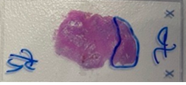
Tumor content titration at 100 ng input
MOL22-013125_S3 | 80% Tumor
Fccall | Brk1 | Brk2 | FC1 | FC2 | sfcall | SF1 | SF2 | Arbcall | A1 | A2 | F1
ETV6:NTRK3 | 12:11869969 | 15:87940753 | 34 | 21 | ETV6:NTRK3 | 103 | 20 | ETV6:NTRK3 | 43 | 17 | 0.73
MOL22-013125_N-S4 | 0% Tumor
Fccall | Brk1 | Brk2 | FC1 | FC2 | sfcall | SF1 | SF2 | Arbcall | A1 | A2 | F1
1 to 2 dil | 40% Tumor
Fccall | Brk1 | Brk2 | FC1 | FC2 | sfcall | SF1 | SF2 | Arbcall | A1 | A2 | F1
ETV6:NTRK3 | 12:11869969 | 15:87940753 | 23 | 15 | ETV6:NTRK3 | 48 | 23 | ETV6:NTRK3 | 25 | 10 | 0.53
1 to 4 dil | 20% Tumor
Fccall | Brk1 | Brk2 | FC1 | FC2 | sfcall | SF1 | SF2 | Arbcall | A1 | A2 | F1
ETV6:NTRK3 | 12:11869969 | 15:87940753 | 21 | 16 | ETV6:NTRK3 | 38 | 13 | ETV6:NTRK3 | 21 | 10 | 0.57
1 to 8 dil | 10 % Tumor
Fccall | Brk1 | Brk2 | FC1 | FC2 | sfcall | SF1 | SF2 | Arbcall | A1 | A2 | F1
ETV6:NTRK3 | 12:11869969 | 15:87940753 | 8 | 13 | ETV6:NTRK3 | 29 | 3 | ETV6:NTRK3 | 20 | 8 | 0.44
MOL22-013125
Tumor Percent | Solid | WTS_solid workflow | WTS_Basespace
80% | ETV6--NTRK3 | ETV6--NTRK3 | ETV6--NTRK3
40% | NA | ETV6--NTRK3 | ETV6--NTRK3
20% | NA | ETV6--NTRK3 | ETV6--NTRK3
10% | NA | Detected | ETV6--NTRK3

Slide 28
Robustness in detection between runs and comparison between DRAGEN server vs in-house pipeline (needs more data, in progress)
Same sample input (100 ng)
BaseSpace Analysis
MOL22-013125 (100 ng)_Run1 | #FusionGene | Score | LeftBreakpoint | RightBreakpoint | Gene1Id | Gene2Id | NumSplitReads
 | ETV6--NTRK3 | 0.999993 | chr12:11869969:+ | chr15:87940753:- | ENSG00000139083.10 | ENSG00000140538.16 | 47
MOL22-013125 (100 ng)_Run2 | #FusionGene | Score | LeftBreakpoint | RightBreakpoint | Gene1Id | Gene2Id | NumSplitReads
 | ETV6--NTRK3 | 0.999987 | chr12:11869969:+ | chr15:87940753:- | ENSG00000139083.10 | ENSG00000140538.16 | 62
In-house Analysis
MOL22-013125
Run | Solid Expected | WTS_solid workflow | WTS_Basespace
Run1 | ETV6--NTRK3 | ETV6--NTRK3 | ETV6--NTRK3
Run2 | NA | ETV6--NTRK3 | ETV6--NTRK3
MOL22-013125_S3
Fccall | Brk1 | Brk2 | FC1 | FC2 | sfcall | SF1 | SF2 | Arbcall | A1 | A2 | F1
ETV6:NTRK3 | 12:11869969 | 15:87940753 | 34 | 21 | ETV6:NTRK3 | 103 | 20 | ETV6:NTRK3 | 43 | 17 | 0.73
MOL22-013125_S17
Fccall | Brk1 | Brk2 | FC1 | FC2 | sfcall | SF1 | SF2 | Arbcall | A1 | A2 | F1
ETV6:NTRK3 | 12:11869969 | 15:87940753 | 27 | 25 | ETV6:NTRK3 | 121 | 11 | ETV6:NTRK3 | 68 | 26 | 0.74

Slide 29
Robustness in detection between runs (weak fusion)
Same sample input (100 ng)
MOL22-010778: Expected from Solid, TMPRSS2--ERG
BaseSpace Analysis
 |  |  | MOL22-010778
 | Input | Tumor content | #FusionGene | Score | LeftBreakpoint | RightBreakpoint | Gene1Id | Gene2Id | NumSplitReads
MOL22-010778 | 100 | 60% | SVEP1--PRUNE2 | 0.998 | chr9:110579013:- | chr9:76850665:- | ENSG00000165124.18 | ENSG00000106772.18 | 17
 |  |  | TMPRSS2--ERG | 0.998 | chr21:41508081:- | chr21:38423561:- | ENSG00000184012.12 | ENSG00000157554.19 | 9
Solid Analysis
MOL22-010778_S1
Fccall | Brk1 | Brk2 | FC1 | FC2 | FCFrame | sfcall | SF1 | SF2 | Arbcall | A1 | A2 | F1
SVEP1:PRUNE2 | 9:110579013 | 9:76850665 | 11 | 14 | in-frame | SVEP1:PRUNE2 | 31 | 5 | SVEP1:PRUNE2 | 15 | 13 | 0.49
KANSL1:ARL17A | 17:46094560 | 17:46570869 | 8 | 15 | out-of-frame | KANSL1:ARL17A | 27 | 7 |  | 0 | 0 | 0.46
TMPRSS2:ERG | 21:41508081 | 21:38423561 | 5 | 9 | UTR/CDS(truncated) | TMPRSS2:ERG | 14 | 0 |  | 0 | 0 | 0.12
MOL22-010778_S1 detected TMPRSS2:ERG as week fusion (expected)

Slide 30
Read support is more for Solid-RNA fusion.
Sample | Brk1 | Brk2 | cytoband | Arbcall | A1 | A2 | A3 | A4 | sfcall | SF1 | SF2 | SF3 | SF4 | Fccall | FC1 | FC2 | Callers | J1 | F1 | class
MOL22-010778 | 21:41508081 | 21:38423561 | del(21;21)( 21q22.2; 21q22.13) | TMPRSS2:ERG | 5 | 47 | 376 | 123 | TMPRSS2:ERG | 106 | 0 | 560 | 29 | TMPRSS2:ERG | 100 | 27 | 3 | 0 | 0.83 | Strong Fusion
MOL22-013125 | 12:11869969 | 15:87940753 | t(12;15)( 12p13.2; 15q25.3) | ETV6:NTRK3 | 300 | 230 | 4254 | 1032 | ETV6:NTRK3 | 1123 | 38 | 4007 | 533 | ETV6:NTRK3 | 1431 | 43 | 3 | 6 | 0.92 | Strong Fusion
MOL22-013125 | 15:88032857 | 12:11884445 | t(15;12)( 15q25.3; 12p13.2) | NTRK3:ETV6 | 33 | 36 | 861 | 3587 | NTRK3:ETV6 | 64 | 18 | 665 | 2775 | NTRK3:ETV6 | 1431 | 25 | 3 | 42 | 0.89 | Strong Fusion
Need optimization in F1 with known fusion in more samples

Slide 31
Input level vs read titrations (FFPE)
 | Status | 10M | 20M | 30M | 40M | 50M | 60M | 70M
 |  | ETV6:NTRK3 | ETV6:NTRK3 | ETV6:NTRK3 | ETV6:NTRK3 | ETV6:NTRK3 | ETV6:NTRK3 | ETV6:NTRK3
100 ng | WTS | Detected | Detected | Detected | Detected | Detected | Detected | Detected
50 ng | WTS | Detected | Detected | Detected | Detected | Detected | Detected | Detected
25ng | WTS | Detected | Detected | Detected | Detected | Detected | Detected | Detected
The QC Metrics for F1 needs to be trained using real samples but as per the read support the fusion was detected
Analyzing more samples for different quality to confirm the number

Slide 32
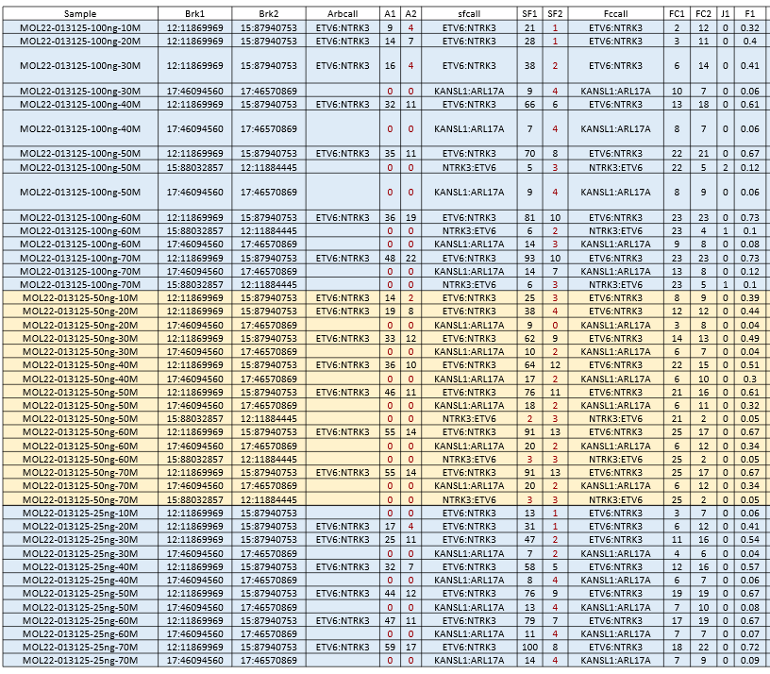
Raw data for down sampling

Slide 33
Heme fusion
Sample | Brk1 | Brk2 | Arbcall | A1 | A2 | sfcall | SF1 | SF2 | Fccall | FC1 | FC2 | F1 | Comment
JEA-020-100ng | 22:23182239 | 9:130854064 | BCR:ABL1 | 16 | 21 | BCR:ABL1 | 32 | 33 | BCR:ABL1 | 43 | 12 | 0.6
JEA-020-100ng-EE | 22:23182239 | 9:130854064 | BCR:ABL1 | 5 | 7 | BCR:ABL1 | 11 | 13 | BCR:ABL1 | 13 | 6 | 0.1
JEA-020-50ng | 9:130714455 | 22:23253799 |  | 0 | 0 | ABL1:BCR | 5 | 7 | ABL1:BCR | 59 | 5 | 0.37
JEA-020-50ng | 22:23182239 | 9:130854064 | BCR:ABL1 | 20 | 32 | BCR:ABL1 | 40 | 44 | BCR:ABL1 | 59 | 14 | 0.74
JEA-020-50ng-EE | 22:23182239 | 9:130854064 |  | 0 | 0 | BCR:ABL1 | 5 | 10 | BCR:ABL1 | 13 | 4 | 0.11
JEA-021-100ng | X:1536921 | X:1212636 | P2RY8:CRLF2 | 11 | 8 | P2RY8:CRLF2 | 26 | 27 | P2RY8:CRLF2 | 33 | 11 | 0.45
JEA-021-25ng | X:1536921 | X:1212636 |  | 0 | 0 | P2RY8:CRLF2 | 16 | 32 | P2RY8:CRLF2 | 28 | 7 | 0.4
JEA-021-50ng | X:1536921 | X:1212636 | P2RY8:CRLF2 | 9 | 5 | P2RY8:CRLF2 | 16 | 28 | P2RY8:CRLF2 | 27 | 8 | 0.35
Summary
Input | Expected | Detected | Status | Globin/rRNA depletion efficiency
JEA20-100 ng | BCR:ABL1 | BCR:ABL1 | TP | High
JEA20-50 ng | BCR:ABL1 | BCR:ABL1 | TP | High
JEA20-25 ng | BCR:ABL1 | BCR:ABL1 | TP | High
JEA20-100 ng | P2RY8:CRLF2 | P2RY8:CRLF2 | TP | NA
JEA20-50 ng | P2RY8:CRLF2 | P2RY8:CRLF2 | TP | NA
JEA20-25 ng | P2RY8:CRLF2 | P2RY8:CRLF2 | TP | NA

Slide 34
Heme Read Support Performed in April,2021
Sample | Brk1 | Brk2 | Arbcall | A1 | A2 | A3 | A4 | sfcall | SF1 | SF2 | SF3 | SF4 | Callers | Frame | J1 | W1 | O1 | J2 | W2 | O2 | FF1 | FF2 | J | F1 | class
JEA020POS-RNA | 22:23182239 | 9:130854064 | BCR:ABL1 | 300 | 300 | 9331 | 3197 | BCR:ABL1 | 702 | 60 | 13059 | 3785 | 2 | in-frame | 6 | 17189 | 2371 | 0 | 4627 | 2690 | 0 | 0 | 6 | 0.82 | Strong Fusion
Sample Input (April,2021)
Run # | DNA Quant (ng/uL) | RNA Quant (ng/uL) | OD 260/280 | DNA Input (ng) | RNA Input (ng) | Batch
7 | 150 | 41.3 | 2.01 | 100 | 100 | QIAseq297-040821RnDRun6Run7
Sample | Status |  | Initial # | % Bases | Insert | % Bases | % Bases | % Mito- | % Ribo- | % Dupli- |  | Filtered # | % Passed | % Mapped | % Uniquely | % Exonic | % Reads | Avg Target | % Targets | % Targets |  | % Bases | % Overl. | % Junc. | Avg Known | Avg Novel | 5'/3'
 |  |  | Reads (M) | ≥ Q30 | Length | UMI+COM | Low Comp | chondrial | somal | cates |  | Reads (M) | Filters | Reads | Mapped | Reads | On Target | Coverage | ≥ 10X | ≥ 500X |  | Usable | Reads | Reads | Junc. Cov | Junc. Cov | Bias
JEA020POS-RNA | PASS |  | 58.59 | 77.67 | 92 | 8.68 | 14.83 | 0.01 | 0.10 | 30.24 |  | 16.32 | 27.86 | 79.01 | 95.78 | 55.21 | 91.61 | 6,269 | 97.25 | 62.69 |  | 15.61 | 46.11 | 30.79 | 952 | 7.3 | 14.69
In WTS we have less read support which can be because of sample stability and multiple freeze thaw over last one year,
Including samples from freshly performed runs.

Slide 35
Fusion Summary
WTS kit can perform for a input range 100 ng to 12.5 ng FFPE tested for strong fusion and to 25 ng for week fusion tested
Robust fusion in a tumor dilution series to 20% in FFPE
Run to run precision is high (tested at 100 ng input)
Heme/rRNA depletion efficiency is high
Fusion in Heme samples can also be tested from 100 to 25 ng of sample input
Next
Testing samples from recent operation run which has strong and week fusion in same samples (in progress)

Slide 36
Expression
Evaluate the chemistry using two FFPE and two Globin samples (Ph+ and Ph –like)
Evaluated based on gene expression data on 297 panel for quick chemistry evaluations for Input range and tumor
Sensitivity
Needs to see expression of all the genes together (TMP calculation is in pipeline)
Observations:
Correlation coefficient is very high in both FFPE and HEME samples from 100 ng, 50 ng and 25 ng showing linearity
Ribosomal-RNA and Globin depletion is effective and needed
Evaluated Hierarchical clustering, heatmap clustering to find lowest input to be 12.5 ng for FFPE and 25 ng for Globin
(did not test 12.5 ng) and tumor dilution to 20% and above
Successfully grouped the Prostate cancer, …., Ph+ and Ph like ALL using the genes from 297 panel as POC for the chemistry
(this saved time for pipelie)
More data is coming for full exome to explore

Slide 37
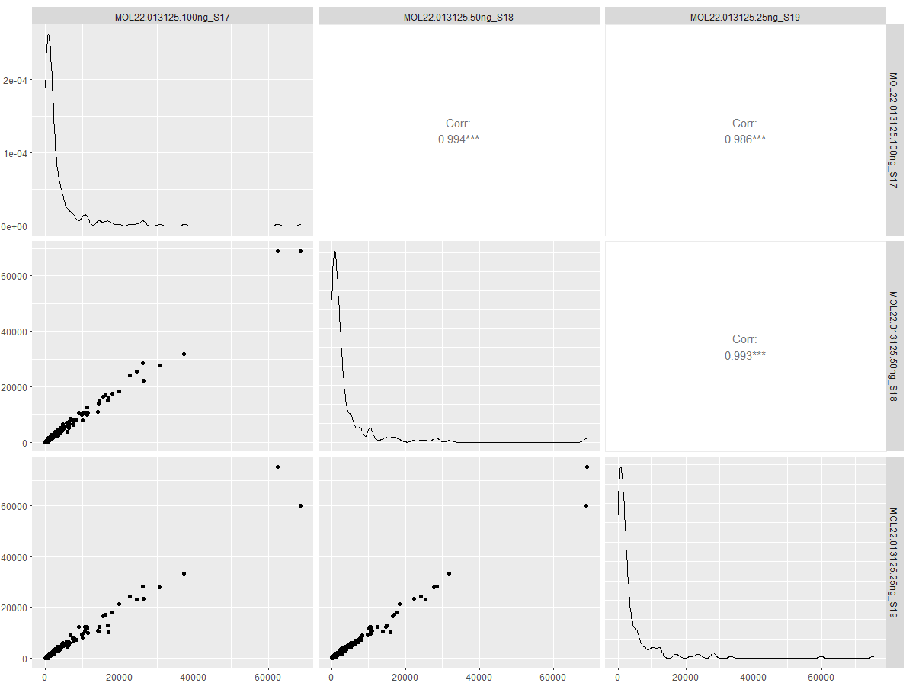
Input Range_Expression FFPE samples:Good correlation between 25 and 100 ng input

Slide 38
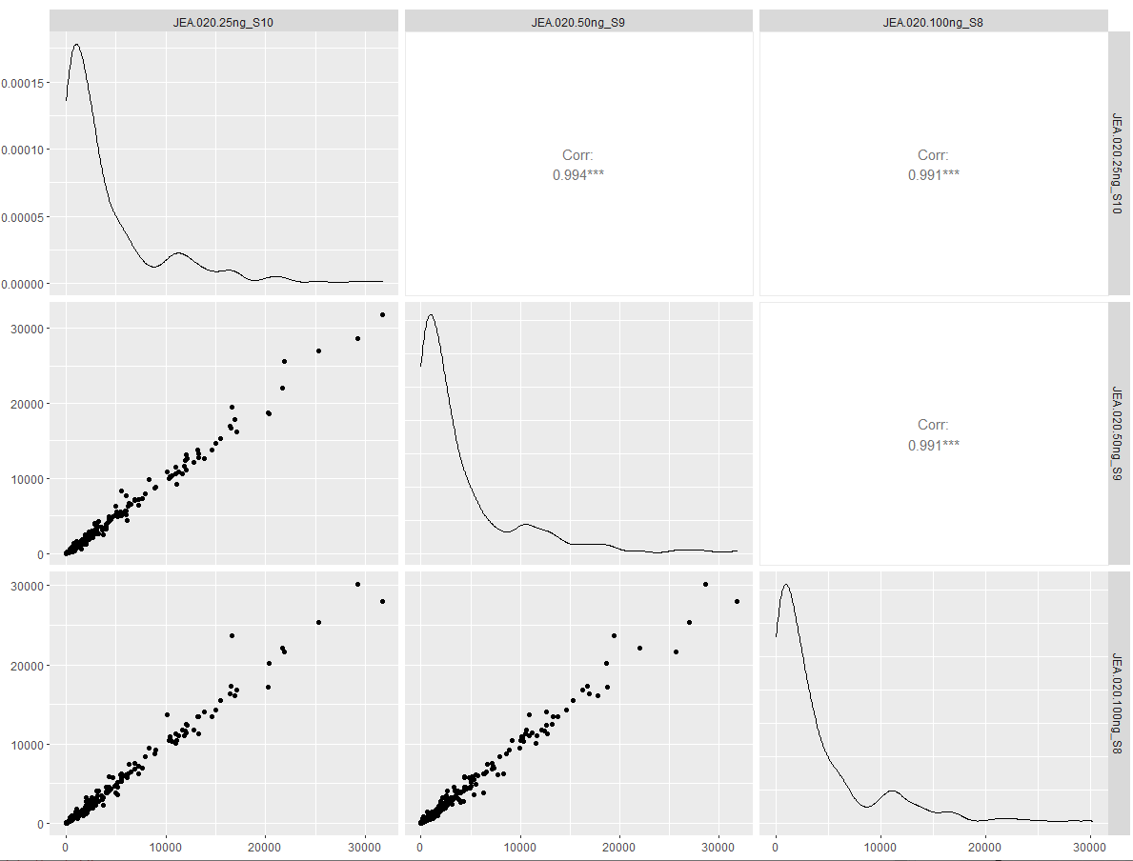
Input Range_Expression Heme: Good correlation between 25 and 100 ng input

Slide 39
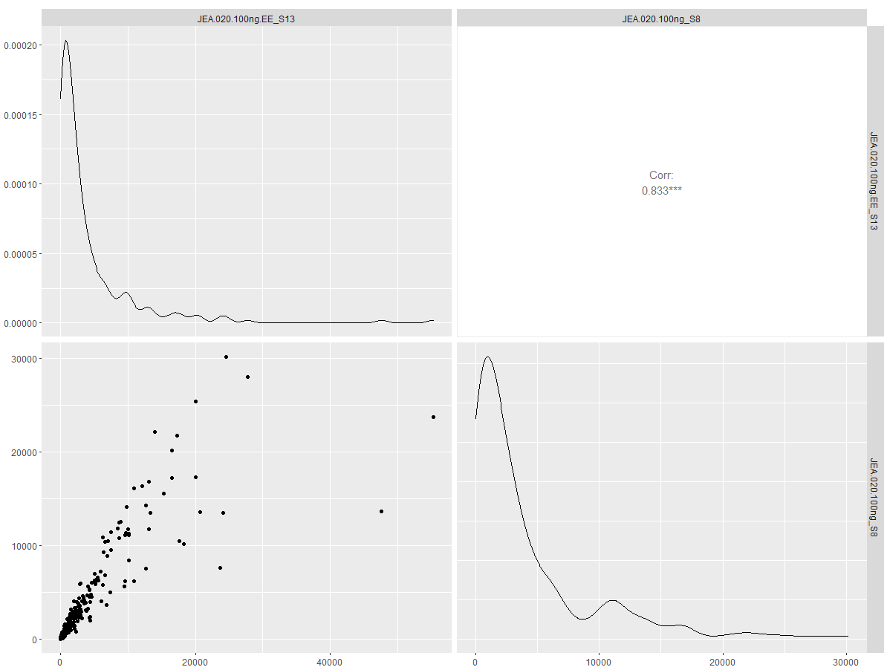
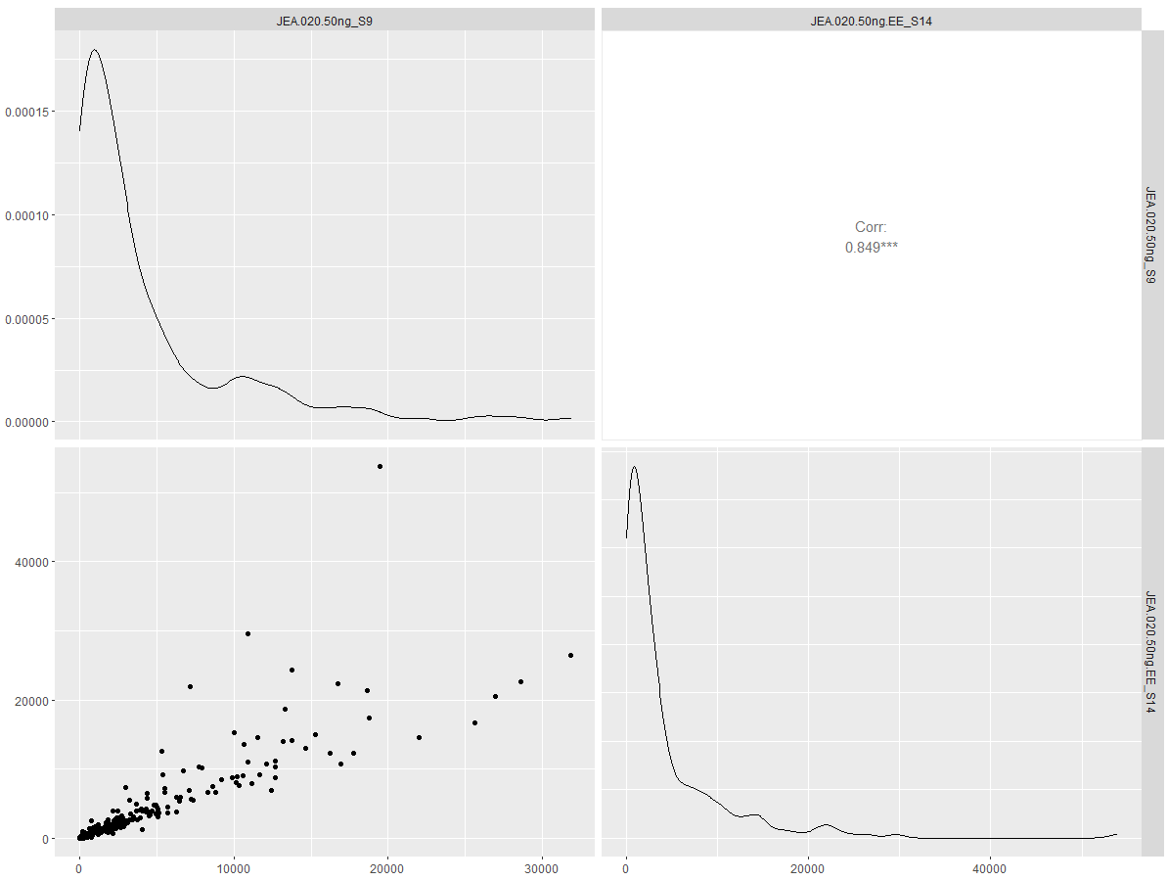
Impact for not having globin and heme depletion: The depletion is effective and needed
100 ng input
50 ng input

Slide 40
Evaluation for Input range and sensitivity for tumor dilution is determined by:
Heatmap
Kmean clustering

Slide 41
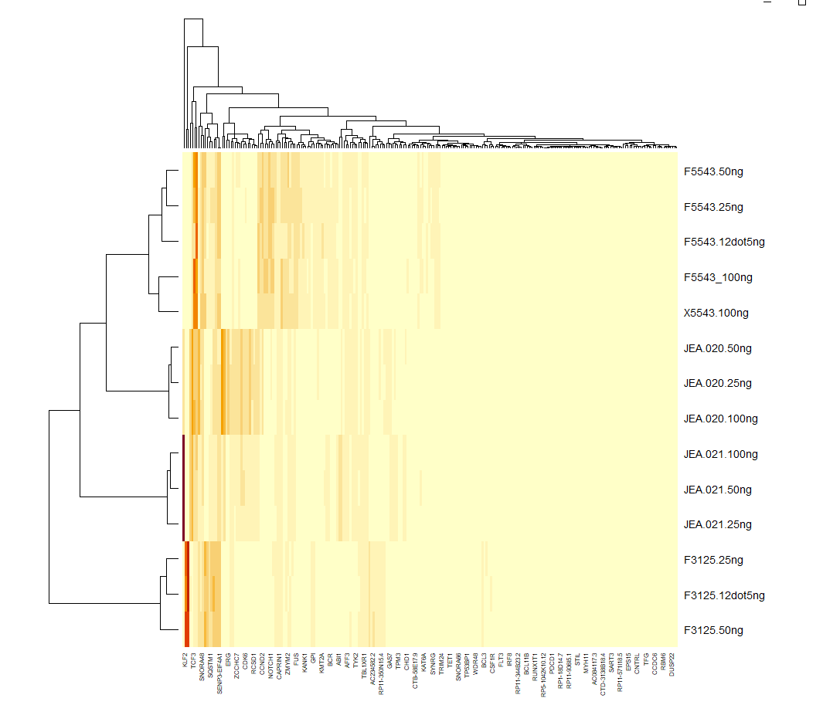
Sensitivity prediction input range for expression in FFPE sample
right temporal brain tissue (FFPE)
Ph+ ALL (Globin)
Ph like ALL (Globin)
Salivary Gland (FFPE)

Slide 42
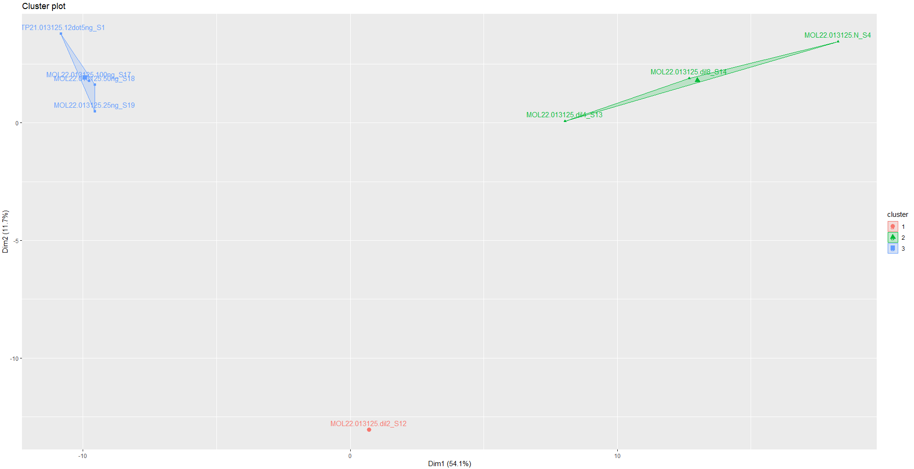
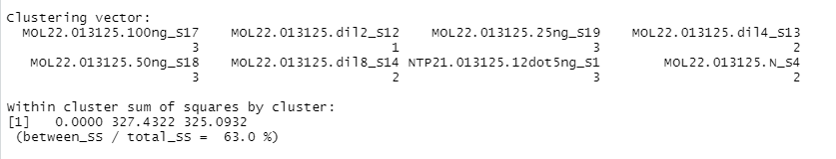
Confirmation on the input range and tumor dilution based on tumor dilution
Cluster membership
Cluster1 | Cluster2 | Cluster3
FFPE_3125-100ng-40% tumor | FFPE_3125-N | FFPE_3125-100ng
 | FFPE_3125-100ng-20% tumor | FFPE_3125-50ng
 | FFPE_3125-100ng-10% tumor | FFPE_3125-25ng
 |  | FFPE_3125-12.5ng
For expression the kmeans clustering shows input can be used until 12.5 ng of FFPE
Beyond 20% tumor content the data starts looking more like normal for expression (unlike fusion)
FFPE_3125-100ng-40% tumor does not belong to native tumor or normal cluster; here we included 275 genes
Next we want to see what will happen when we include all expression gene; Exp data (TPM ) are in analysis pipeline now

Slide 43
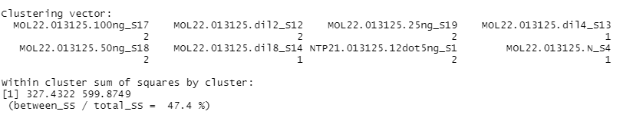
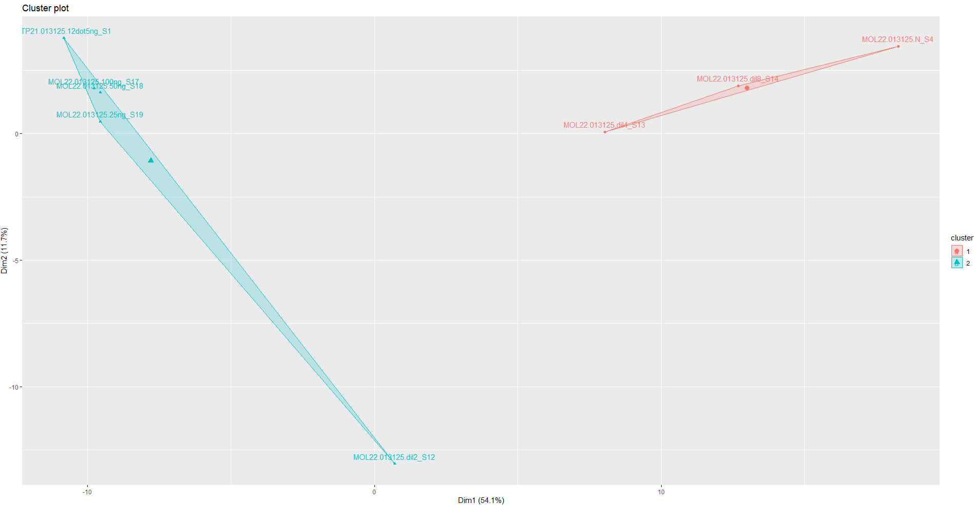
Compromise in cluster quality between 2 vs 3 clusters using FFPE samples at 100,50,25,1.2 ng input and 80%,40% ,20% and 10% tumor purity

Slide 44
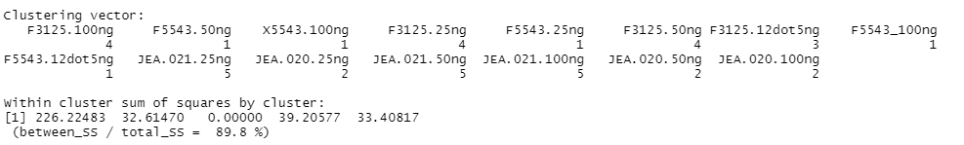
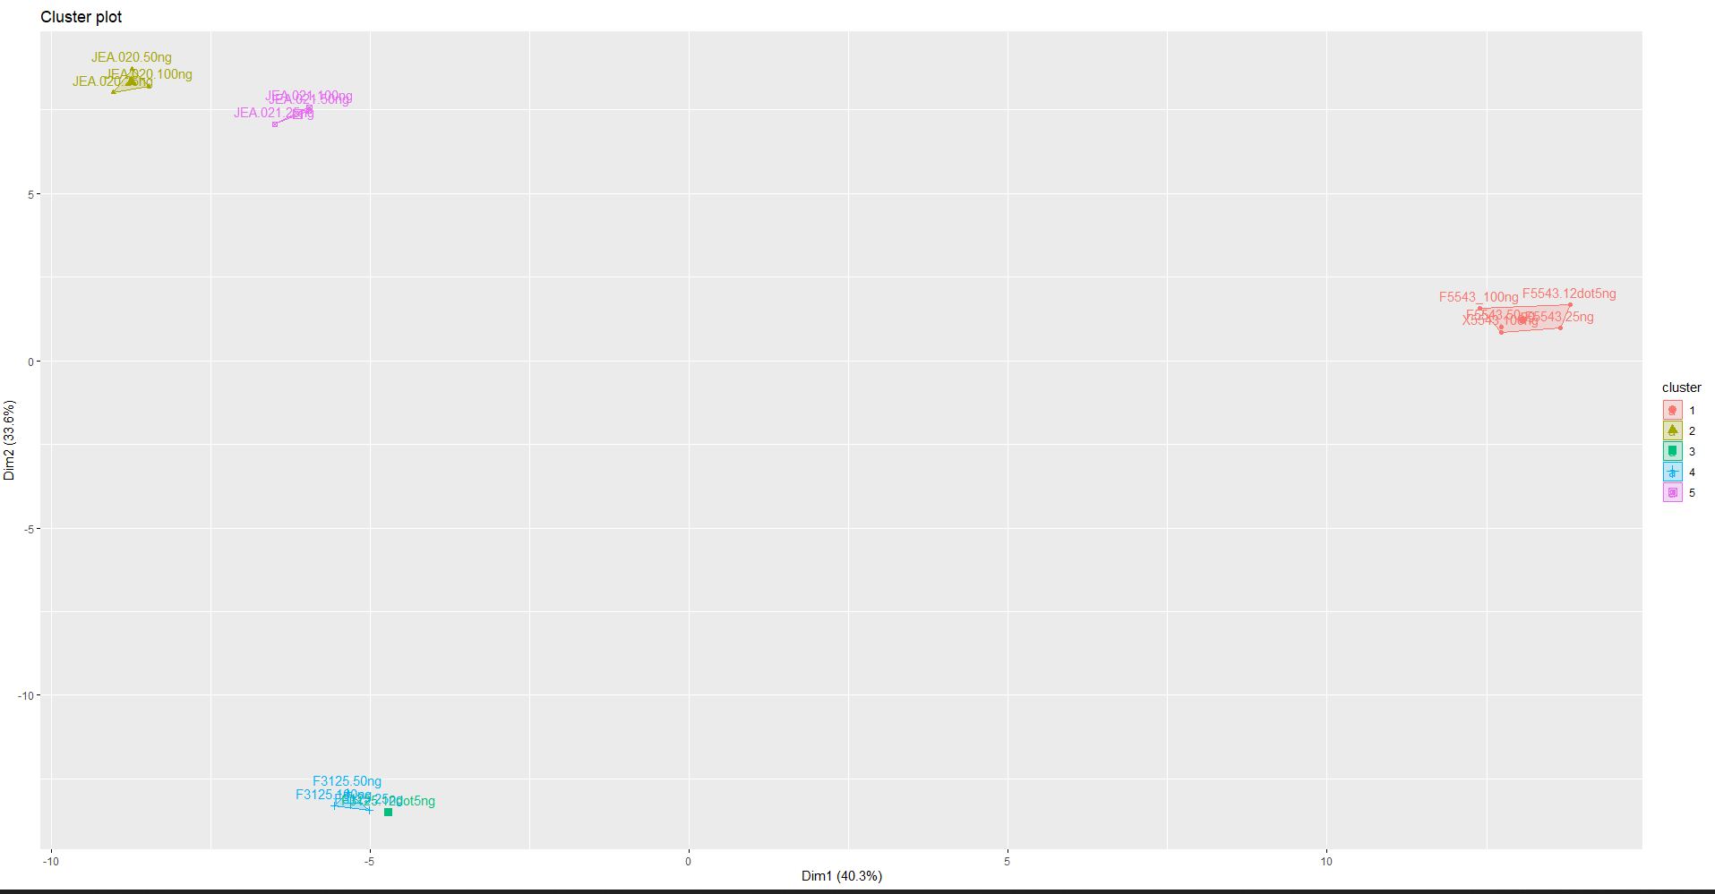
Input range for subtyping for different FFPE samples and Heme (Ph+ or Ph like ALL)
Cluster membership
Cluster1 | Cluster2 | Cluster3 | Cluster4 | Cluster5
FFPE_5543-100ng | JEA.020-100ng | FFPE_3125-12.5ng | FFPE_3125-100ng | JEA.021-100ng
FFPE_5543-50ng | JEA.020-50ng |  | FFPE_3125-50ng | JEA.021-50ng
FFPE_5543-25ng | JEA.020-25ng |  | FFPE_3125-25ng | JEA.021-25ng
FFPE_5543-12.5ng
BCR-ABL1
Ph+ ALL
CRLF2-P2R8y
Philadelphia like ALL
Clinical Importance
ALL
right temporal brain tissue
BCR-ABL1?
Yes
Ph+ (t(9;22)(q34;q11)
NO
Ph like
Poor prognosis
Poor prognosis
GEF (CRLF2 is major)
Fusion
CRLF2, ABL1/2,CSFR1,PDGFR A/B,EPOR,JAK2
The OE can cause by:
Mutation for IKZF1 for CRLF2
JAK Mutation (JAK2R683)
IL-7 receptor alpha chain
(IL7RA)
Salivary gland Solid

Slide 45
Summary
Fusion
Observation:
Steady performance until 25 ng of input for FFPE and Globin samples
Minimum amount of reads required is 40M from 100 ng to 25 ng input
Initial Run-to-run performance is robust (need to more samples and run)
In-house pipeline is more specific with built-in QC metrics
Expression
Observations:
Correlation coefficient is very high in both FFPE and HEME samples from 100 ng, 50 ng and 25 ng showing linearity
Ribosomal-RNA and Globin depletion is effective and needed
Evaluated Hierarchical clustering, heatmap clustering to find lowest input to be 12.5 ng for FFPE and 25 ng for Globin
(did not test 12.5 ng) and tumor dilution to 20% and above
Successfully grouped the Prostate cancer, salivary gland, Ph+ and Ph like ALL using the genes from 297 panel as POC for the chemistry (this saved time for pipeline)
More data is coming for full exome to explore for all other genes (in thousands)

Slide 46
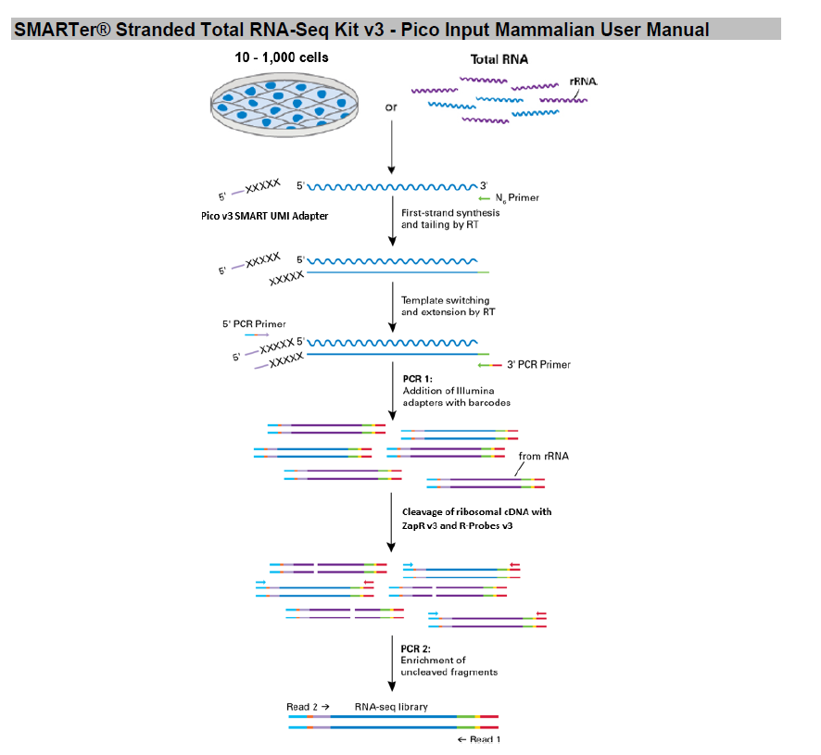
Takara: Under testing
Sample Type | Wide variety including globin rich blood sample_Not part of Kit
FFPE | Yes
UMI included | No
Sample Input | 1-1000 ng 10 ng min for FFPE
Runtime (Total) | 7 hr
Hands on | <3
Stranded | Yes
Human cytoplasmic rRNA | Not part of Kit_ Different vendor
Mitochondria rRNA | Not part of Kit_Different vendor
Human beta globin transcripts | Not part of Kit: Different vendor
Automation | Capable
Analysis | Included
COGs (excluding sequencing) | About $100 per sample or less

Slide 47
Initial data looks run Q30 is about 75% and passing filter is also low
Gets lot of fusion from their pipeline , we miss some known fusion
Need to test more samples in Takara

Slide 48
Thank you everyone in WES and WTS team

Slide 49
Bk Up

